Slide 1


Daeyeon Lee
Department of Chemical and Biomolecular Engineering
University of Pennsylvania

Slide 2
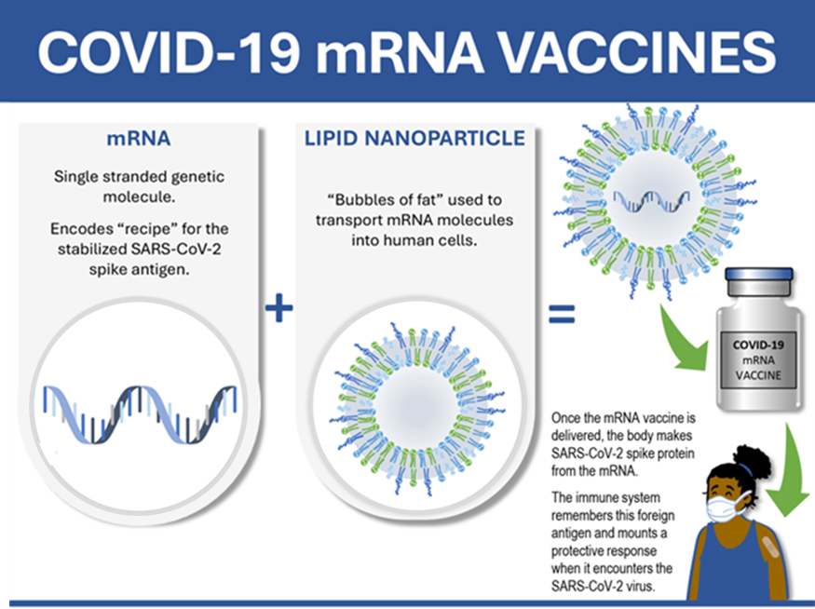
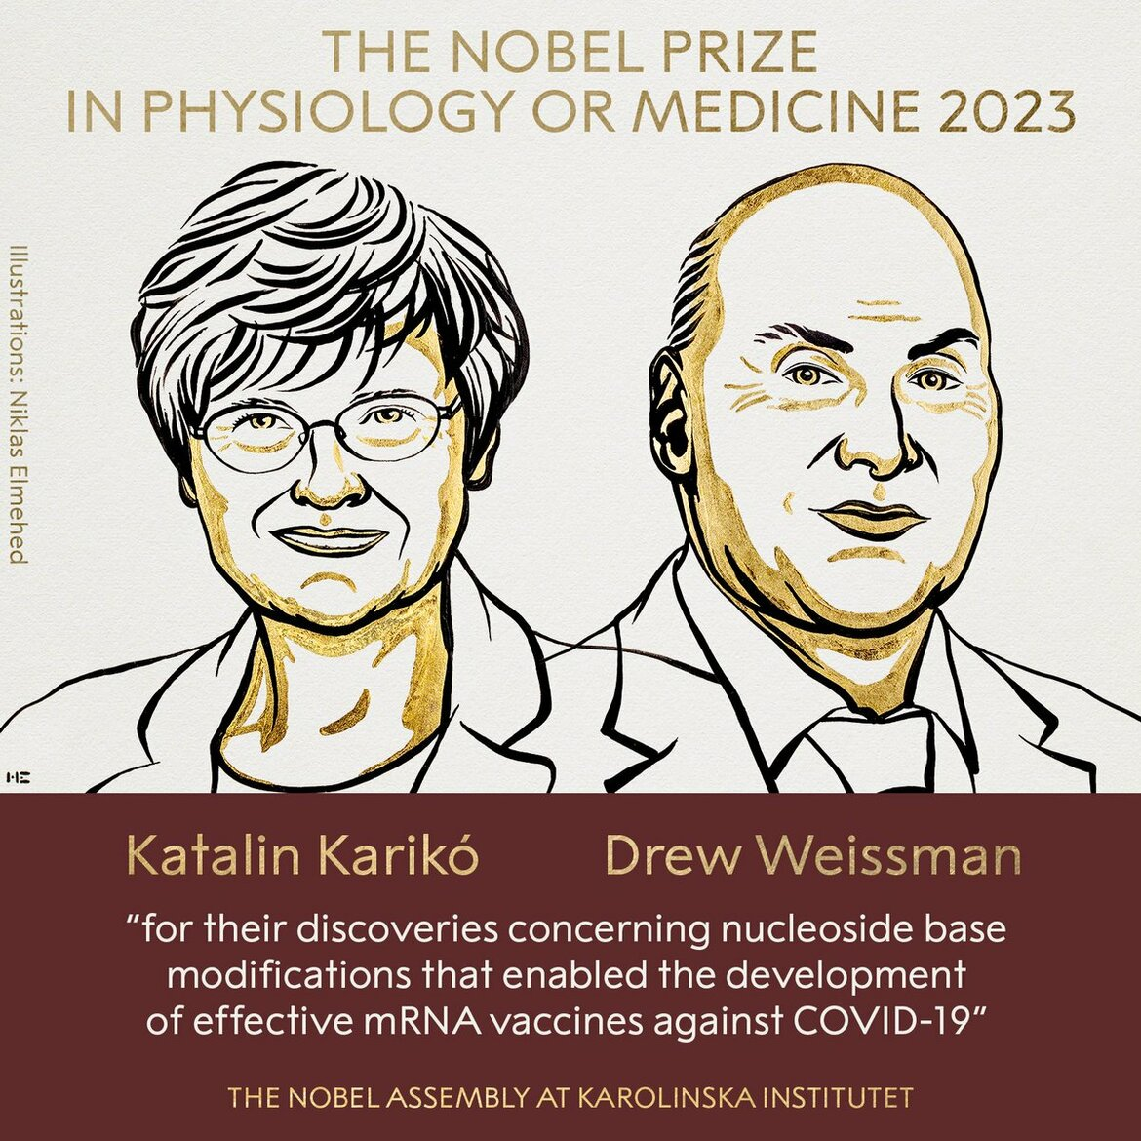
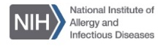
RNA and LNP Revolutionized Human Health
(LNP)
14M - 20M lives saved world-wide

Slide 3
Unresolved Major Challenges
RNA
Fragile
Optimization of RNA sequence
Production of high-quality RNA
Lipid Nanoparticles (LNPs)
Lack of design rule
Delivery to specific cells, organs
Poor control over uniformity
Computational and Engineering Tools
Difficult to combine knowledge and best practices
Lack of digital tools for robust and safe production
Inequitable access to high-quality RNA and LNPs

Slide 4
Vision & Specific Objectives of AIRFoundry
Our vision is to transform RNA design, synthesis, and delivery, and to democratize their use in bioscience discovery and applications.
We achieve this vision by integrating:
AI-augmented design of RNA & lipid nanoparticle (LNPs) and precise production through automation;
An AI-augmented facility for state-of-the-art instrumentation

Slide 5
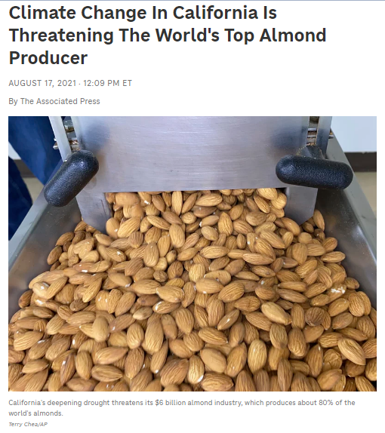
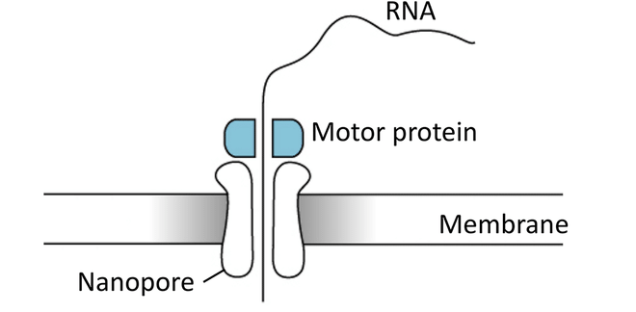
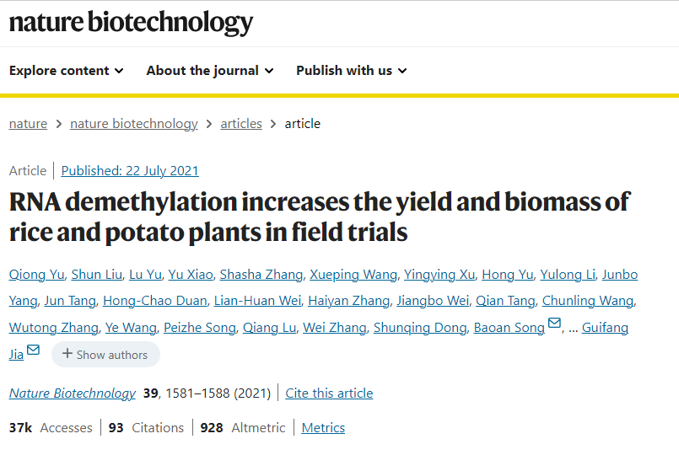

…teams will explore … making crops more resistant to blight and disease…
Imani
Postdoctoral Fellow in Biophysics

Slide 6

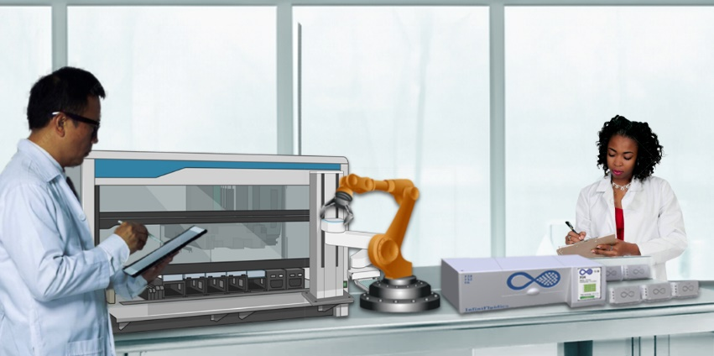

AIRFoundry
Multi RNA
production
Multi LNP
production
AIRFoundry scientists

Slide 7

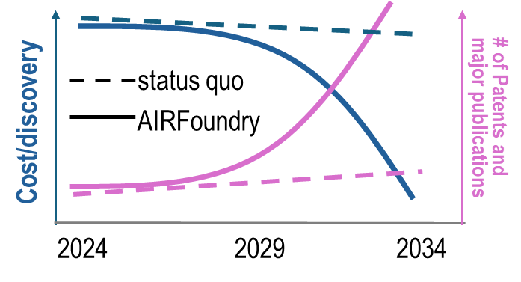


Conclusions & Outlook:
AIRFoundry Will Lead the RNA Revolution
Democratize access to state-of-the-art materials and knowledge in RNA and LNP
Drive transformative innovations across biosciences and biotech applications
Train an inclusive next generation of intellectual leaders that will tackle global challenges in fundamentally new ways

