Slide 1


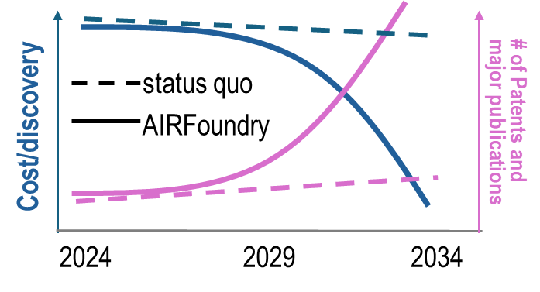

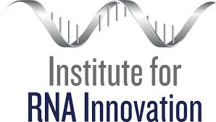




Our vision is to transform RNA design, synthesis, and delivery, and to democratize their use in bioscience discovery and applications.
Accepting collaborative proposals and orders for RNA synthesis and LNP formulation.
Website: airfoundry.org
Email: airfoundry@seas.upenn.edu
Notes:
We achieve this vision by integrating:
AI-augmented design of RNA & lipid nanoparticle (LNPs) and precise production through automation;
An AI-augmented facility for state-of-the-art instrumentation

Slide 2
Our vision is to transform RNA design, synthesis, and delivery, and to democratize their use in bioscience discovery and applications.
Accepting collaborative proposals and orders for RNA synthesis and LNP formulation.
Website: airfoundry.org
Email: airfoundry@seas.upenn.edu
Notes:
We achieve this vision by integrating:
AI-augmented design of RNA & lipid nanoparticle (LNPs) and precise production through automation;
An AI-augmented facility for state-of-the-art instrumentation

